Slide 1
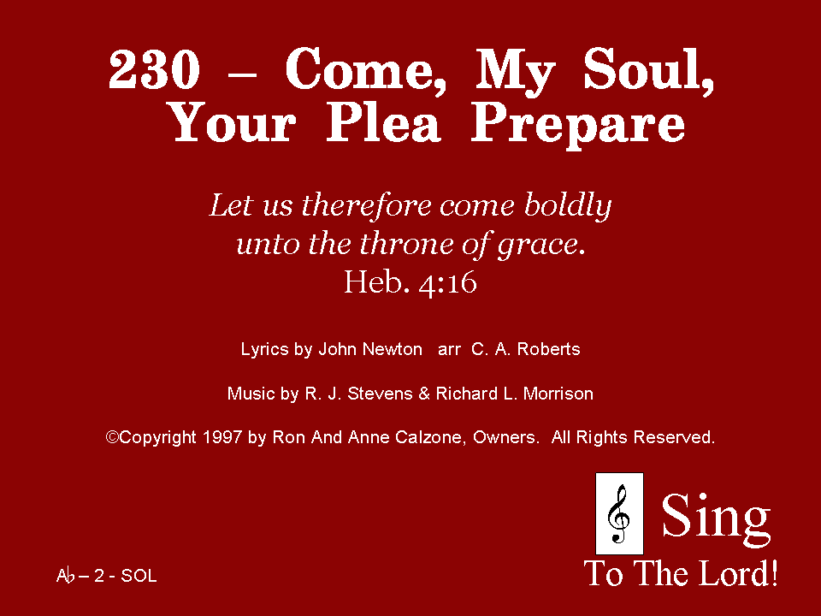
230 - Come, My Soul, Your Plea Prepare - Title

Slide 2
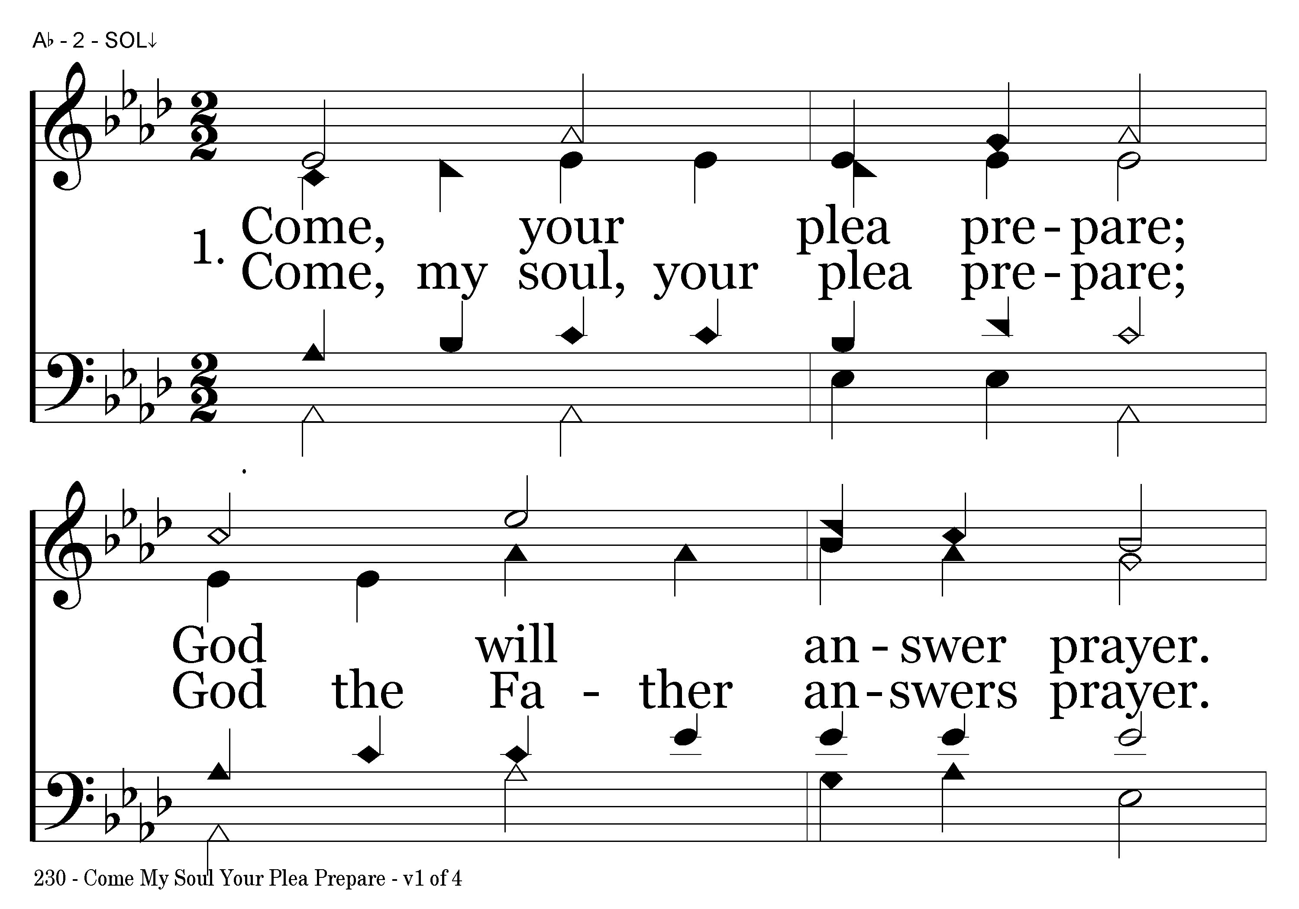
230 - Come, My Soul, Your Plea Prepare - 1.1

Slide 3
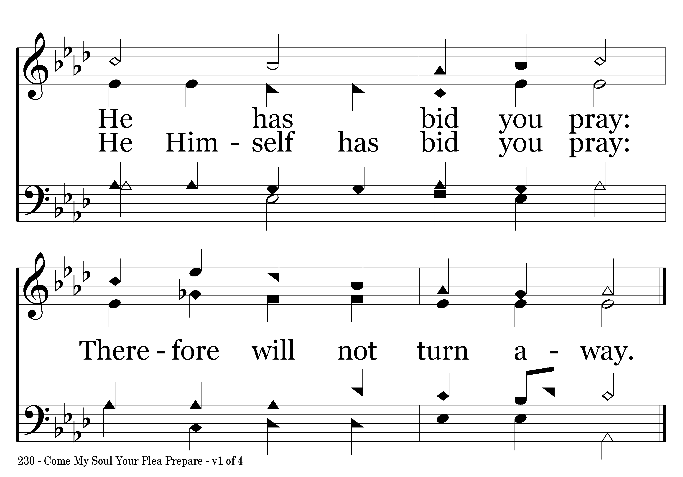
230 - Come, My Soul, Your Plea Prepare - 1.2
End of Verse 1

Slide 4
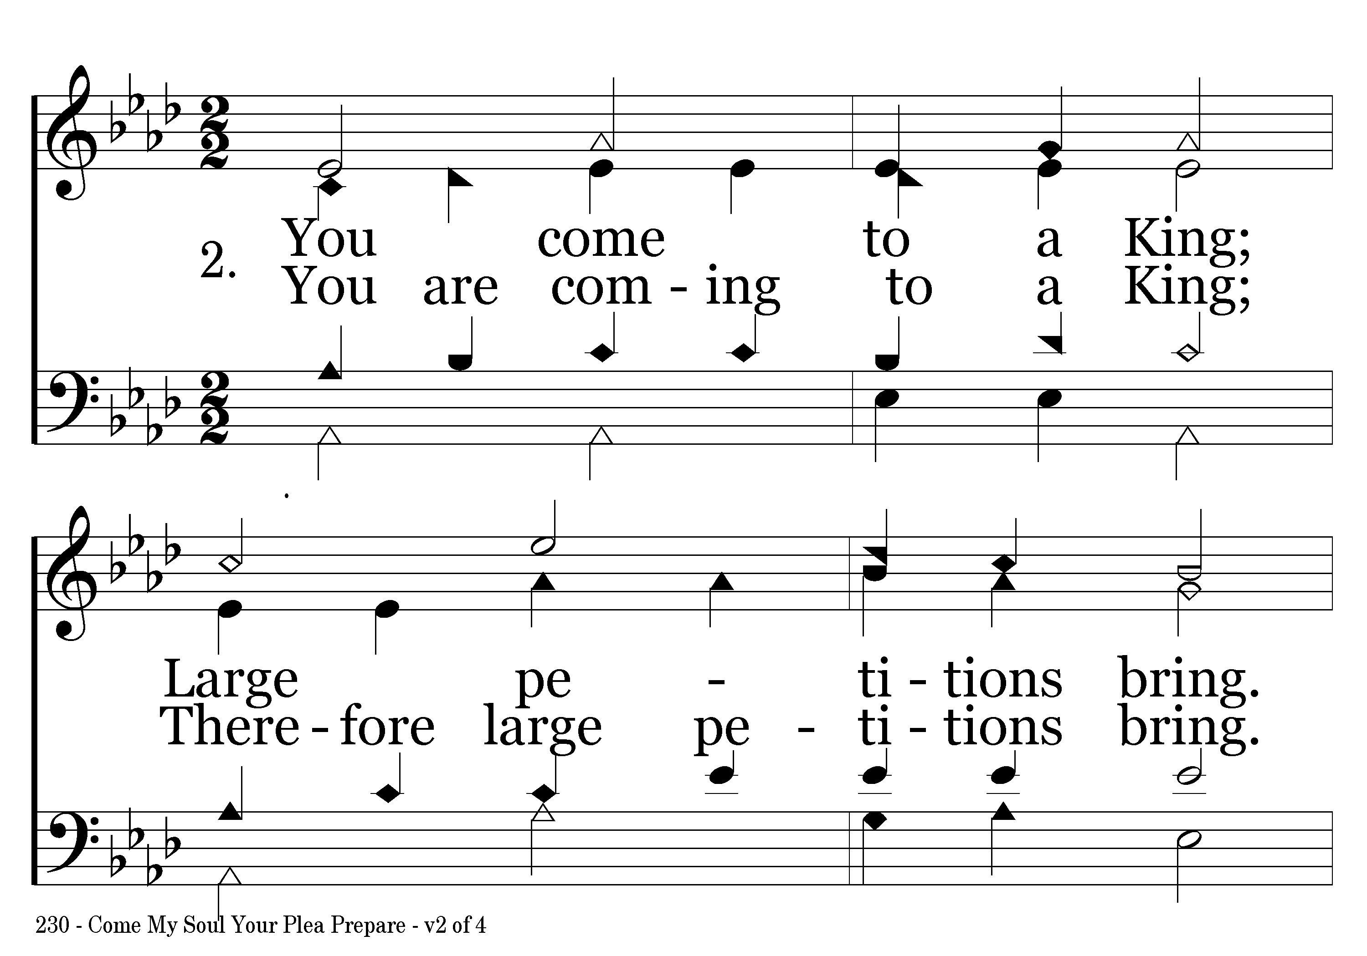
230 - Come, My Soul, Your Plea Prepare - 2.1

Slide 5
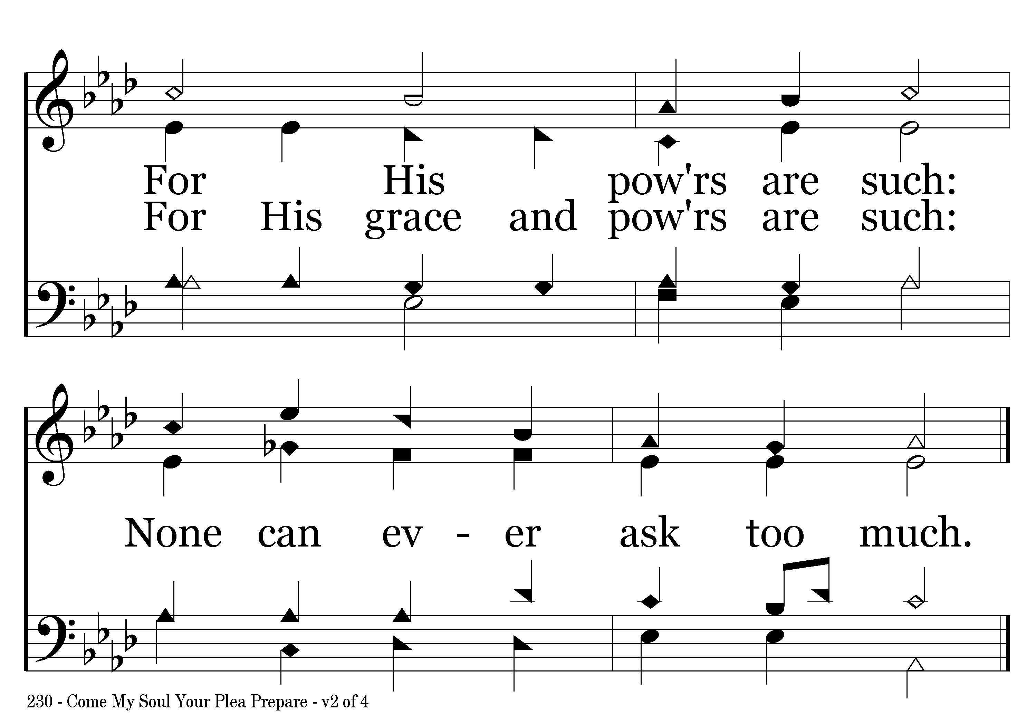
230 - Come, My Soul, Your Plea Prepare - 2.2
End of Verse 2

Slide 6
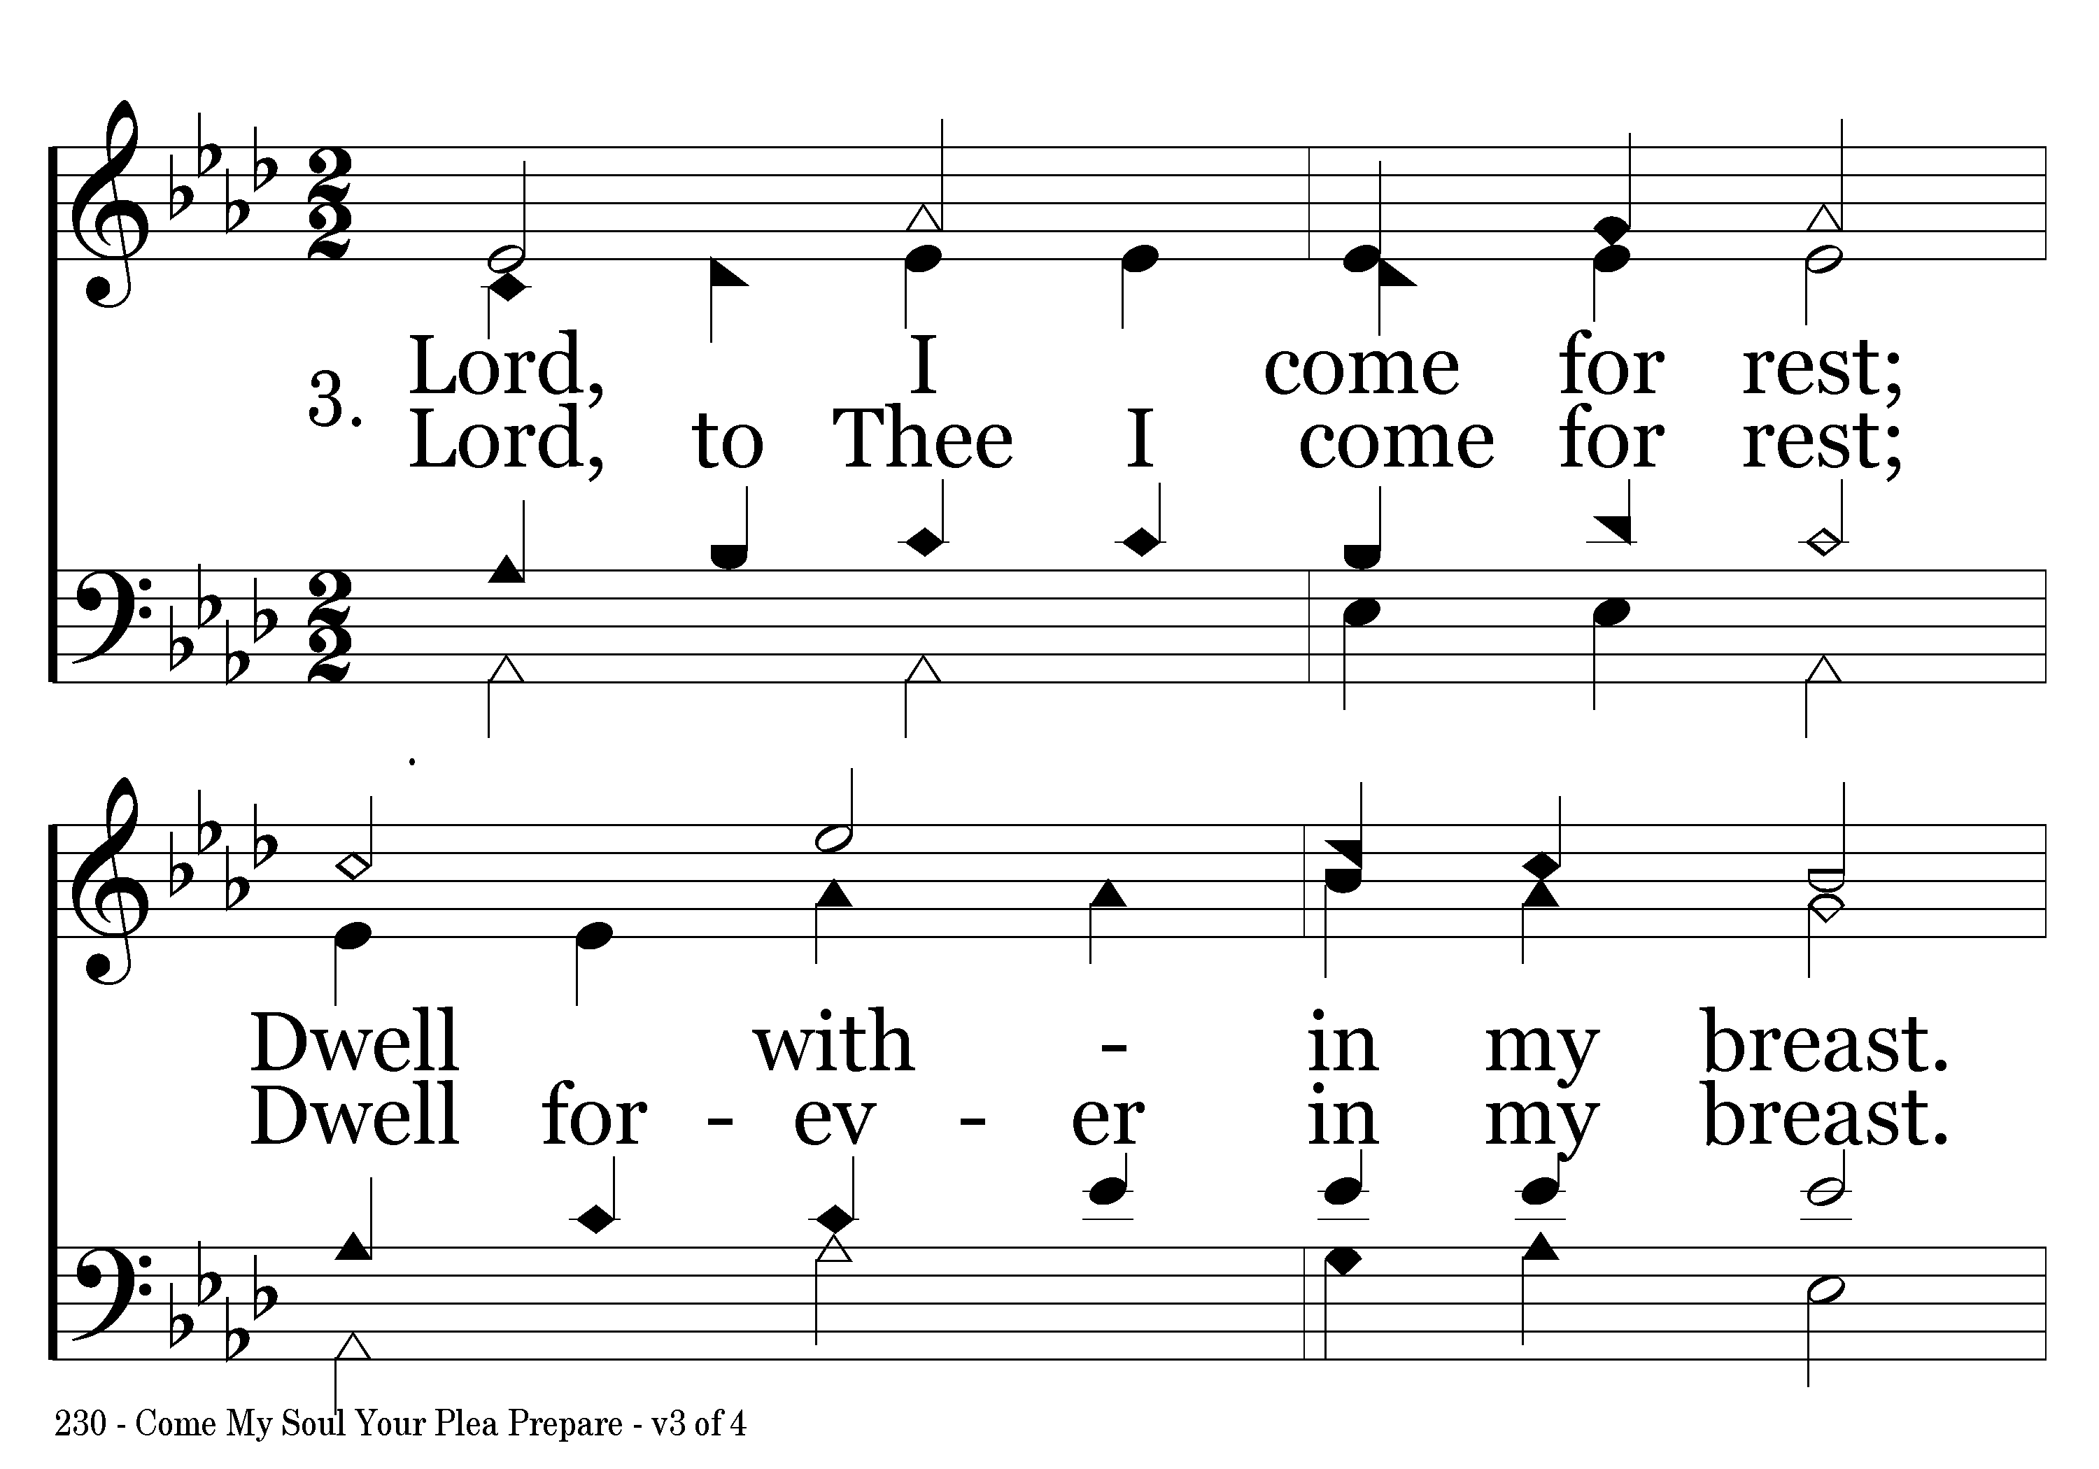
230 - Come, My Soul, Your Plea Prepare - 3.1

Slide 7
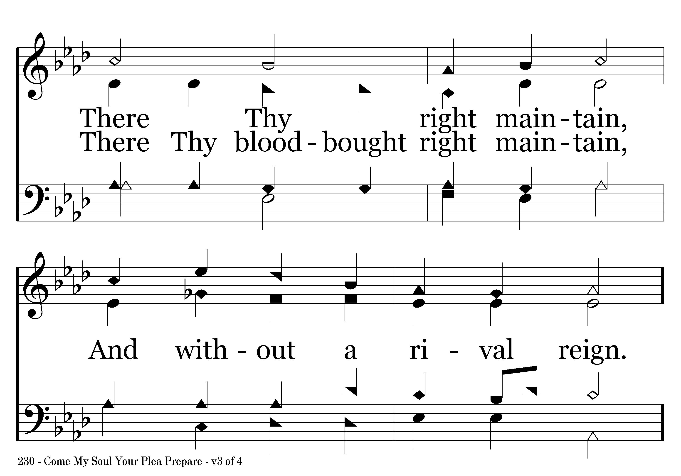
230 - Come, My Soul, Your Plea Prepare - 3.2
End of Verse 3

Slide 8
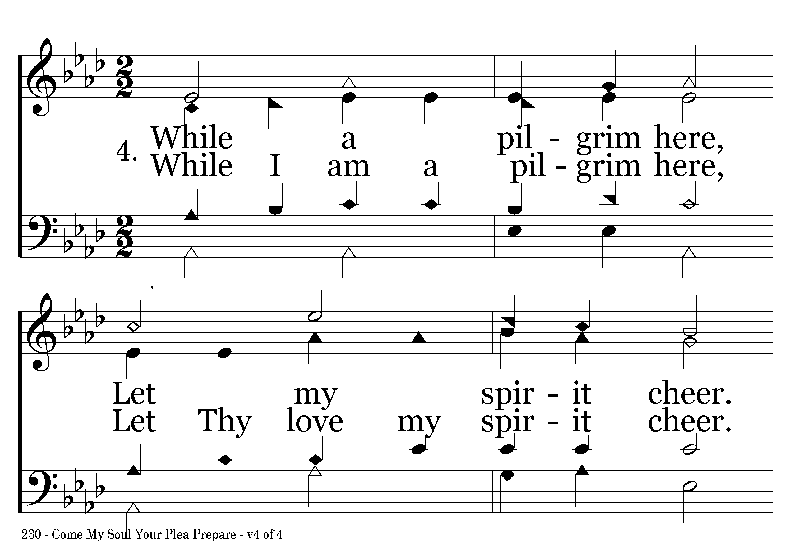
230 - Come, My Soul, Your Plea Prepare - 4.1

Slide 9
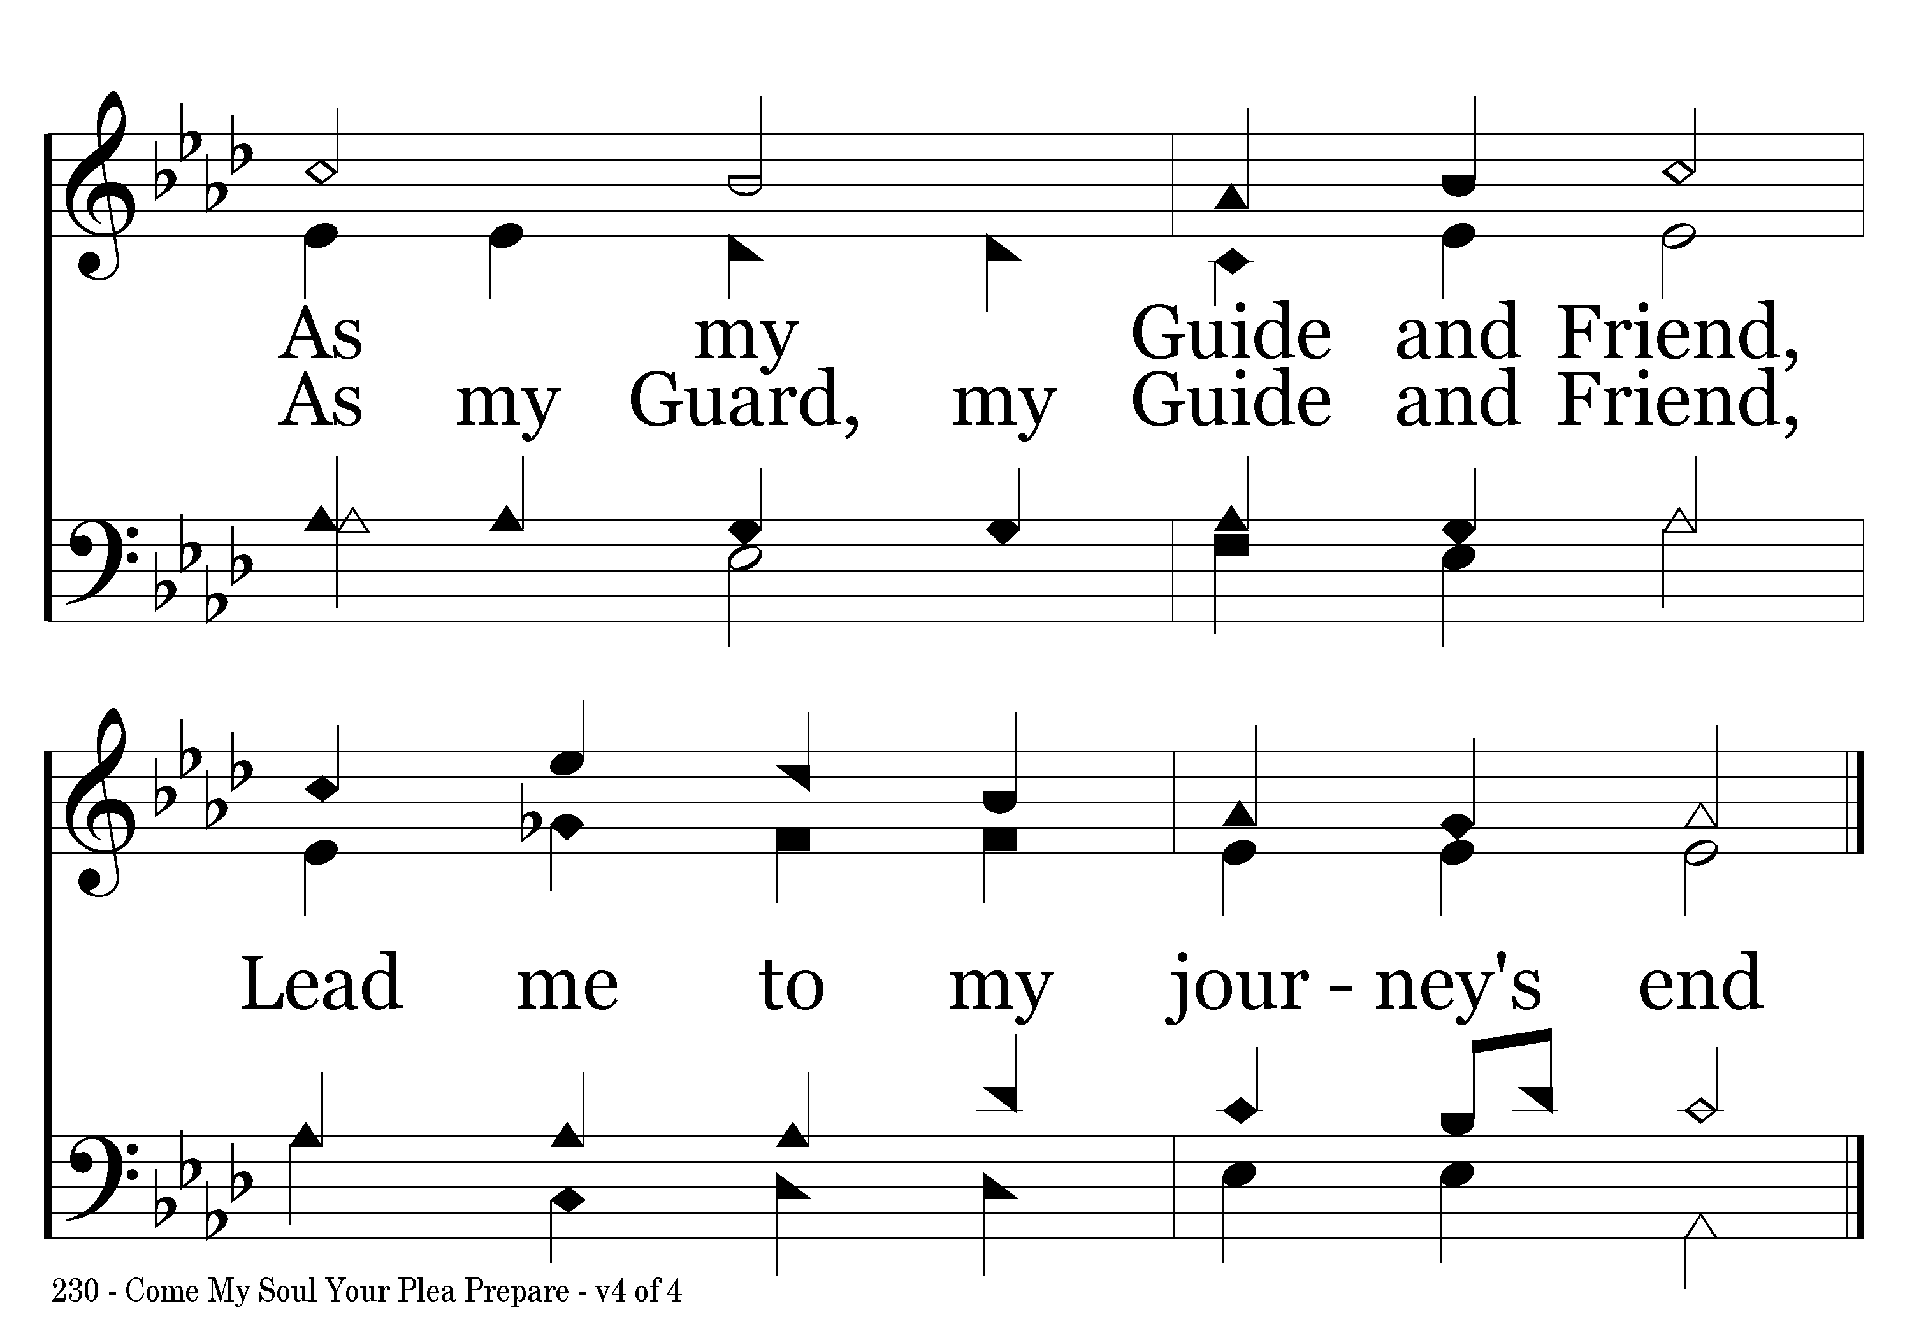
230 - Come, My Soul, Your Plea Prepare - 4.2
End of Song

